Slide 1
1 L/s Plants in Parallel
CEE 4540
TEAM CHANCEUX

Slide 2
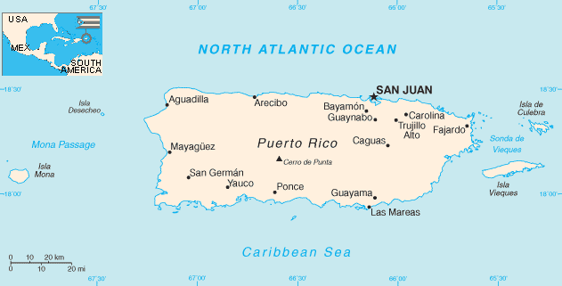
Project Goal and Context
1 L/s plants in parallel
Widening AguaClara’s reach
CHANCEUX
Notes:
SUNG MIN:
Recently, a 1 L/s plant was developed based on AguaClara technology to bring sustainable water treatment to communities with smaller needs (300 people per plant). This project was thought of as the possibility of widening AguaClara’s reach to be helpful in Puerto Rico’s post hurricane rebuild effort.
The goal of this project was to assess whether the portable 1 L/s plant could be a viable option to help rural communities have safe drinking water. The project models multiple 1 L/s plants working in parallel to provide for the community and plans for the future for when communities would add capacity.

Slide 3
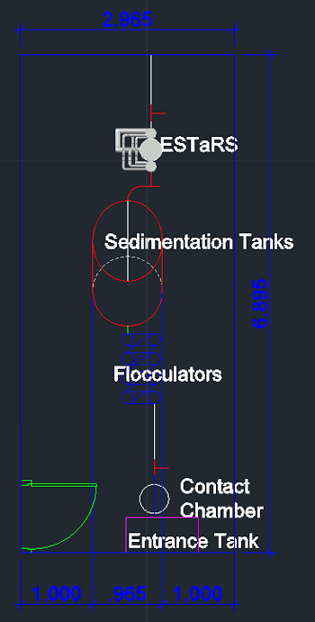
Design Steps and Key Constraints
Modular designs for each plant
One entrance tank and CDC
Parallel layout
Extendable chain-link fencing shelter walls
Manifolds (using Ts and fernco caps)
KEY CONSTRAINTS: FLOW RATE and MANIFOLD CAPACITY
CHANCEUX
Notes:
SUNG MIN:
We don’t have much experience building and deploying 1 LPS plants so our project didn’t take into consideration of the economics and ease of operation compared to the built in place plants. The project focused on determining the spacing, dimensions and manifolds and making functions for those. We made our target variable be the plant flow rate and calculated the flow rate of the coagulant and flocculator size. A key constraint was the plant flow. Because we couldn’t do any comparisons with the built in place plants, we took 6 L/s as our constraint because it is the smallest built in place plant capacity.
In order to make our project more applicable and standardized as a general solution, we decided to make our design modular. Meaning each plant has one ESTaRS and Flocculator. Our design included one entrance tank and contact chamber, and used a parallel layout for convenience. We have extendable chain-link fencing wall to make it easy to increase the dimensions of the shelter when adding capacity. When we say adding capacity, we mean increasing the amount of flow by adding plants. And we have manifolds: one that connects up to 3 plants from the sedimentation tank to the ESTaRS and another after filtration to equate the flow for chlorination.
*point to the 1 LPS plant design

Slide 4
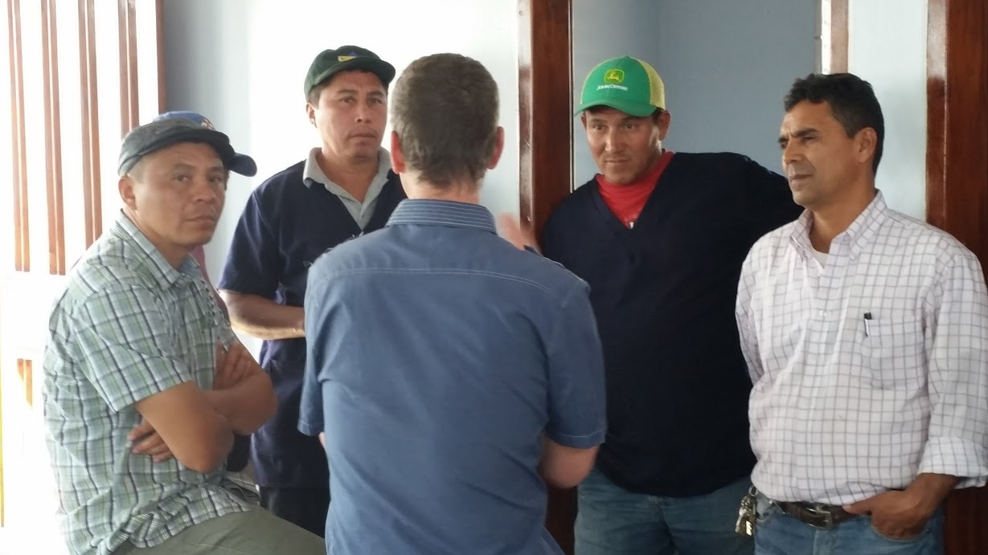
Analysis Methods
Ease of implementation
Operator needs
Space constraints
Flow rate constraint
CHANCEUX
Notes:
FELIX:
Analysis Method: We planned different scenarios with the number of plants with known minimum distances between each part of the plant. Used constraints
Standardizing modular designs
Parallel layout because of convenience
Incorporate of a wall that extends to accommodates adding capacity
Calculating distance between sedimentation tanks, filters, platforms
For the dimensions of everything and placement, we kept the operator and ease of implementation in mind.
Explain manifolds

Slide 5
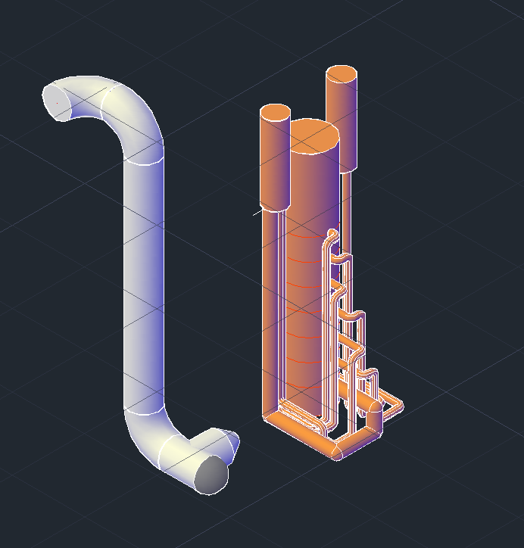
Explored Paths ``````````````````````````
Plant Layout
Manifold Layout
Economic Costs
Number of Plants
Cap
CHANCEUX
Notes:
FELIX:
We explored different options of the layout of the plants and chose the parallel layout due to convenience; Extendable side of the shelter.
Manifold Layout. We tried to find out the maximum number of plants that can be connected to the manifold and decided three because we found out that it is difficult to obtain 4 way connector
Economic costs. We initially wanted to compare the costs of the 1 LPS but we found out that the cost estimates are difficult because the economics and ease of operation is still generally unknown.
Number of plants. We initially wanted to base our number of plants on the population size of rural Puerto Rico but found that to make our project more useful as a general solution, we should have the flow rate of the plant be the target variable and that should be determined on a case-by-case.

Slide 6
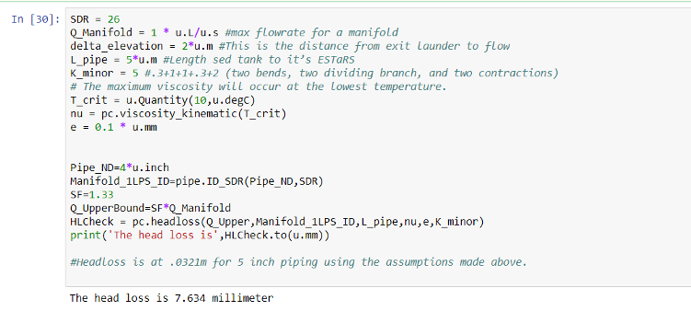
Significant Findings from Design Development
Having 1 LPS plants in parallel is possible
Manifolds are possible
CHANCEUX
Notes:
PRIYA: We were unsure if it were possible to have manifolds with headloss small enough to be in the millimeters.
Having 1 lps plants in parallel is possible
Manifolds are possible. Manifolds have enough negligible headloss with a 4 inch pipe so that we can backwash our filters.

Slide 7
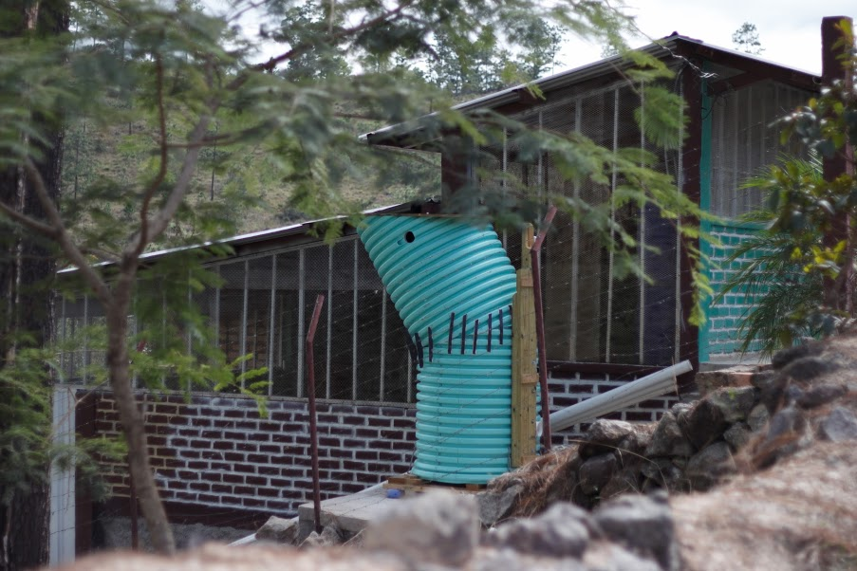
Applications
Application: Implementation
Recommend: Data collection, collaboration
CHANCEUX
Notes:
PRIYA:
We envision implementation of the 1 LPS plants to communities and to plan for the future by considering adding capacity
Recommendations for AguaClara:
Collect more data and experience on implementations of 1 LPS.
Contact AIDE Design subteam to update our code and to do the same for the built in place plants
(starting stages so the recommendations are not super specific)

Slide 8
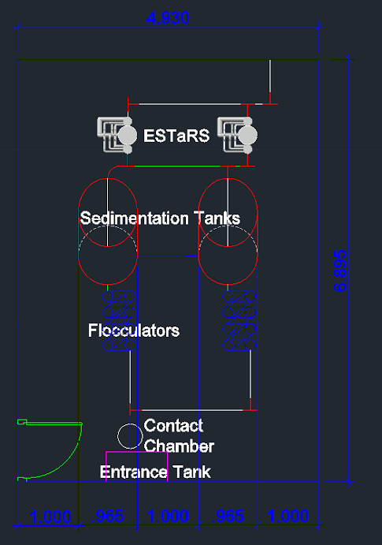
AutoCAD designs
2 LPS plant
CHANCEUX
Notes:
FELIX:
The sample 2 L/s plant. The red t's indicate where the piping system can be expanded to include more 1 L/s plants. Additionally the t exit that isn't connected to any piping would be covered by a fernco cap so that the pipe can be removed when the plant is adding capacity.

Slide 9
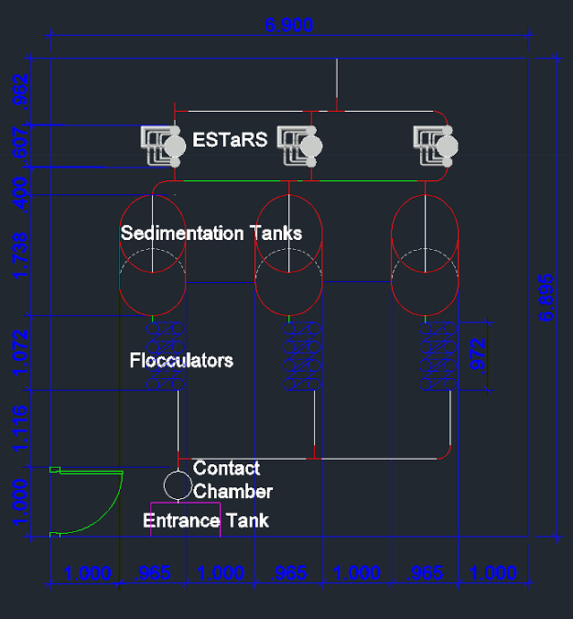
AutoCAD designs
3 LPS plant
CHANCEUX
Notes:
FELIX:
The sample 3 L/s plant. There are now no more t's that can be extended because the manifold was designed for up to 3 1 L/s plants. Further capacities are added on the bottom half of the plant like in the next 3 pictures.

Slide 10
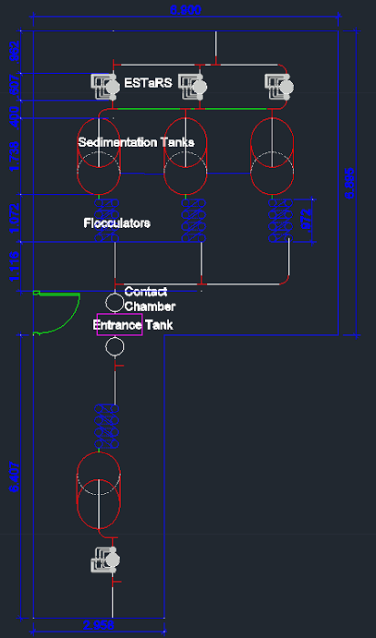
AutoCAD designs
4 LPS plant
CHANCEUX
Notes:
FELIX:
The sample 4 L/s plant. Like in the 1 L/s plant the red t's indicate the start of the 2nd manifold system.

Slide 11
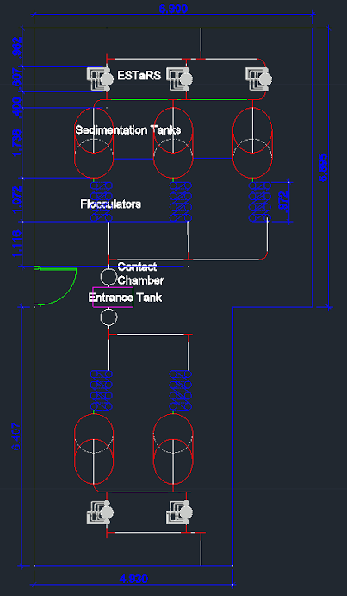
AutoCAD designs
5 LPS plant
CHANCEUX
Notes:
FELIX:
The sample 5 L/s plant. The length (x-direction) is extended by the diameter of a sedimentation tank and one meter like in the top half of the plant. However the width of the bottom half is slightly lower because it can use the already built entrance tank used for the first 3 L/s systems.

Slide 12
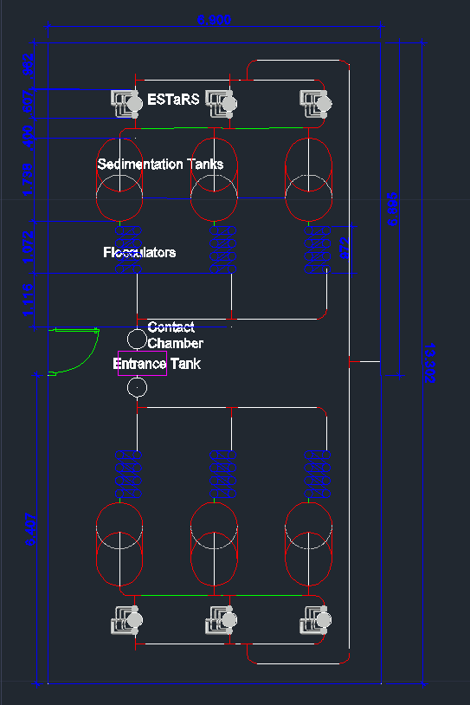
AutoCAD designs
6 LPS plant
CHANCEUX
Notes:
FELIX:
The sample 6 L/s plant. The building is now at full capacity with an area of 91.74 m^2. The flow reunites to allow for chlorination to be administered at one point.

Slide 13
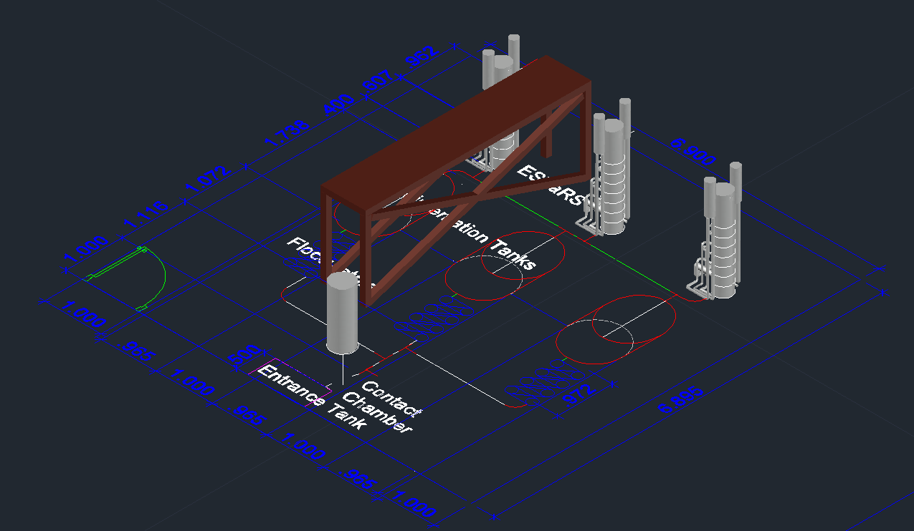
AutoCAD designs
Platform
CHANCEUX
Notes:
FELIX:
Please Input

Slide 14
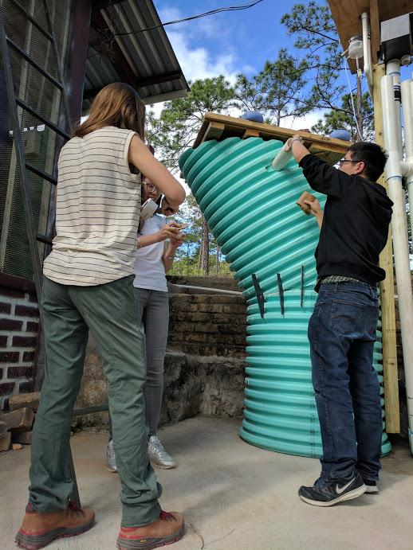
What we learned
Applicability of 1 LPS in parallel
AguaClara built in place plants design can transfer to 1 LPS plant design
CHANCEUX
Notes:
PRIYA:
What we learned: We learned that when designing 1 lps plants in parallel we should allow them to be expandable so that if the community wants to increase the flow rate they can have that option, and that the design for this is not too complicated in terms of adding pipes and Ts to the plant and should be fairly easy to execute. We also tried to apply what has been done for previous AguaClara plants in our design such as the platform we added so that the operator can view the sedimentation tank.

Slide 15
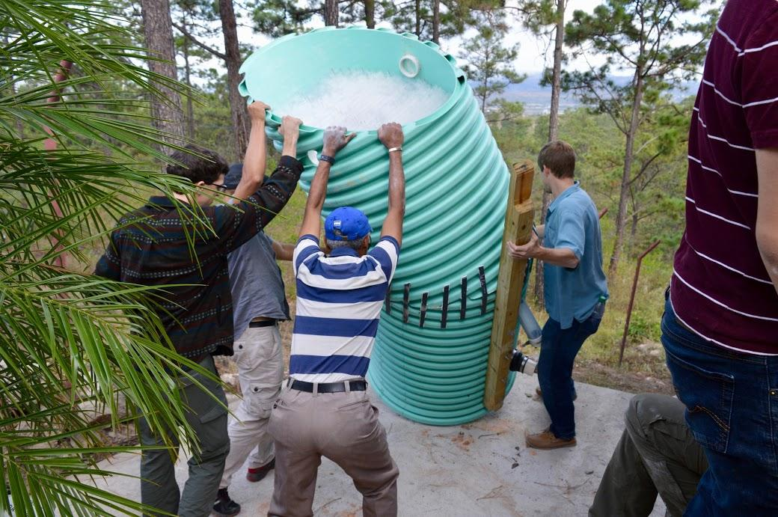
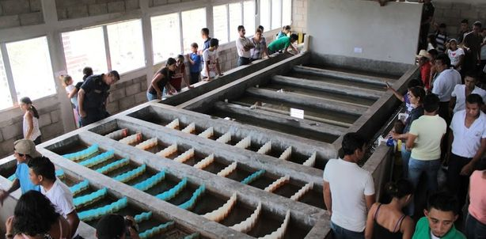
Further Development
Some aspects remain to be designed
Exploring existing constraints
Cost analysis
Notes:
(SUNG MIN)
We didn’t touch the entrance tank and contact chamber. The entrance tank should be designed so that the LFOM is modular to the plant. Explore different layouts for efficient land use. Because for the built in place AguaClara plants, there was a good deal of time that was spent playing with different plant layout configurations and debating the optimal elevation of the walkways, so our constraints definitely are not final. We also should do a cost analysis to calculate the economic cost involved and compare with built in place plants.

Slide 16
Questions and Recommendations
Felix Yang
B.S. Env. Engineering
fyy2@cornell.edu
Sung Min Kim
B.S. Env. Engineering
sk2795@cornell.edu
Priya Aggarwal
B.S. Civil Engineering
pa289@cornell.edu
CHANCEUX

